Slide 1
Mental Health at Workplace

Slide 2
Team Members
Gowthami Middela
Ashish Manchala
Yasaswi Nallamothu
Gangai Kaliprasad

Slide 3

Introduction
With the development of new data sources and analytical methods, data science has become more and more prevalent in the healthcare industry. In terms of mental health, there is a huge unmet demand in the world. Data science can contribute to our understanding of mental health issues. We may use data science to more fully comprehend and successfully apply treatments for mental health issues.

Slide 4
Challenge
How to handle mental health at the workplace
Mental Health affects mental, psychological, and social well-being. It also affects how we think, feel and act. It also helps us in determining how we handle stress by relating it to others. The impact of mental health on an organization can mean a lot of things: an increase in absent days from work, Decrease in productivity. In the US, approximately 70 percent of adults with depression are in the workforce. Employees with depression will miss a lot of days.

Slide 5
Solution
This problem can be solved using Mental Health First Aid. It helps participants to notice and support individuals who are suffering from mental health. It teaches employees communication and support skills which can help people suffering from mental health.
Research shows that employees who used first aid have increased awareness of mental health among themselves and their co-workers. It allows them to recognize the signs of someone who is struggling with mental health and teaches them the skills to when and where to reach out.
Moreover, they conduct an Employee Assistance Program which focuses on mental and physical health. These measures can help create a healthy and productive work environment that reduces the stigma associated with mental illness.

Slide 6
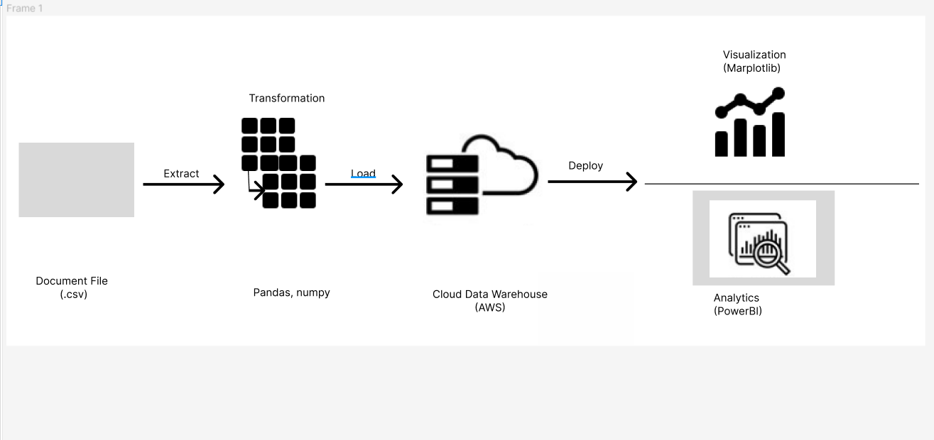
Graphical View of ETL Tools :

Slide 7
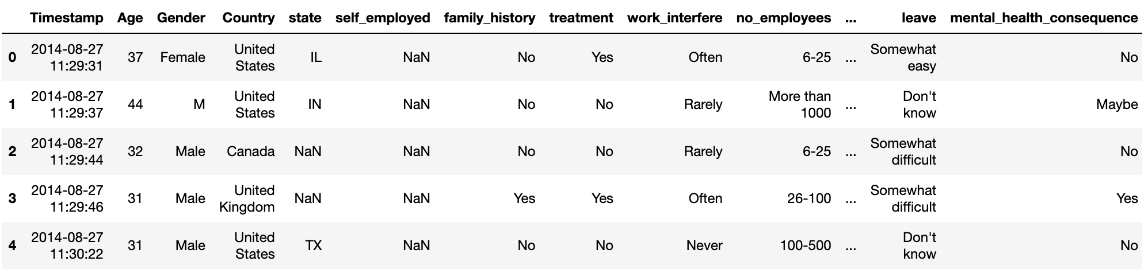
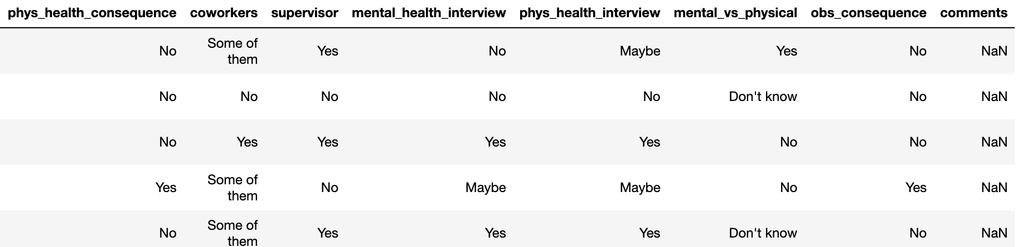
Data from Kaggle
https://www.kaggle.com/datasets/osmi/mental-health-in-tech-2016

Slide 8
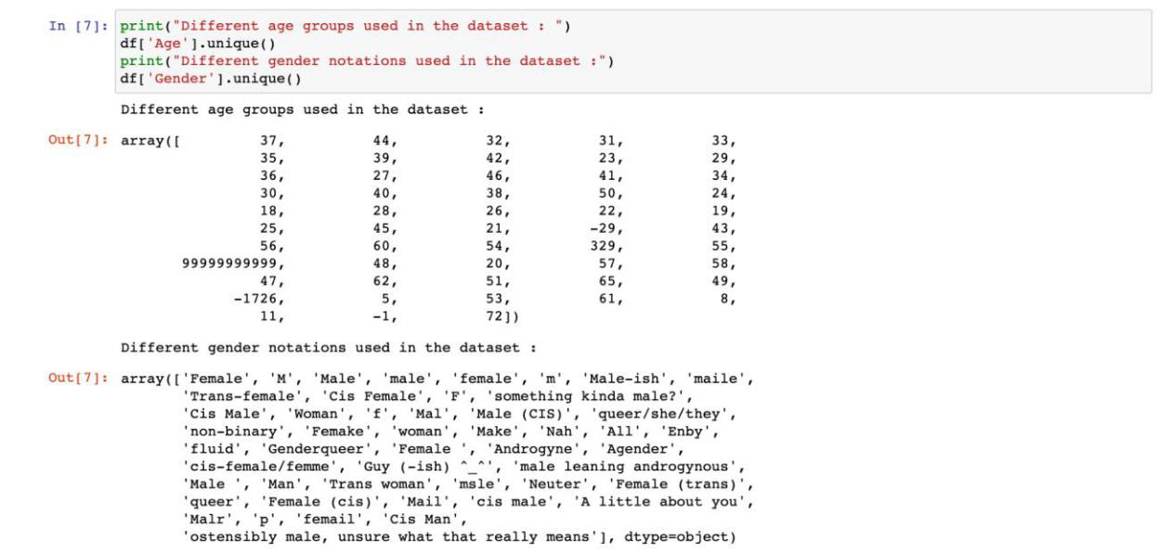
Data Preparation and Feature Engineering :
How can age be negative? And how can the age be less than 20? Are they allowed to even work?
So in these cases, we are making the age column from 20 to 100.

Slide 9
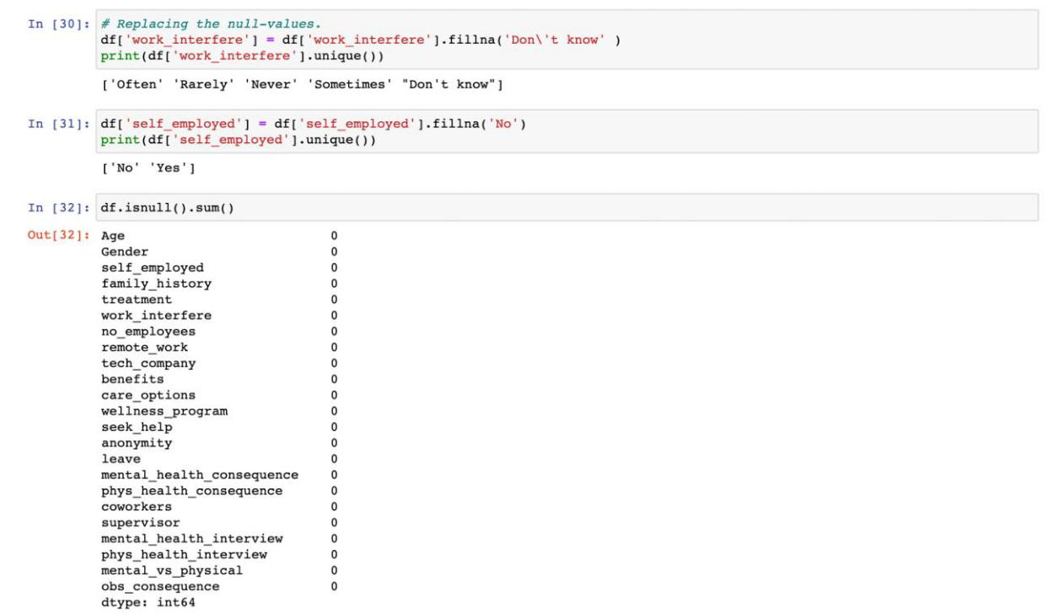
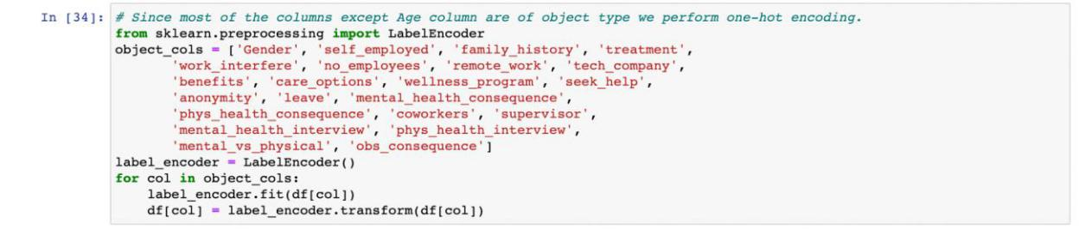
Since most of the columns except the Age column are of object type we perform one-hot encoding.

Slide 10
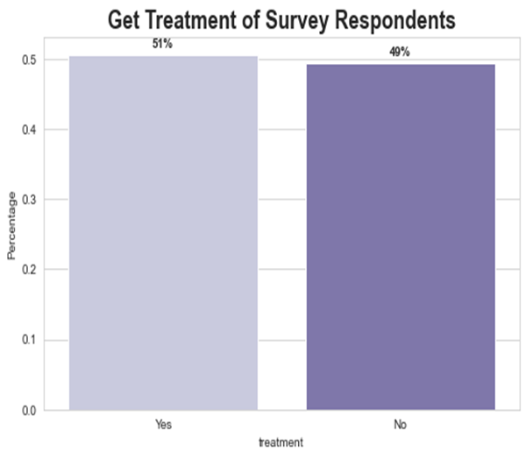
Exploratory Data Analysis
From this graph we can infer the percentage of respondents who want to get treatment is 50%. If employees have good mental health they can : Be more productive, Take active participation in employee engagement activities etc.

Slide 11
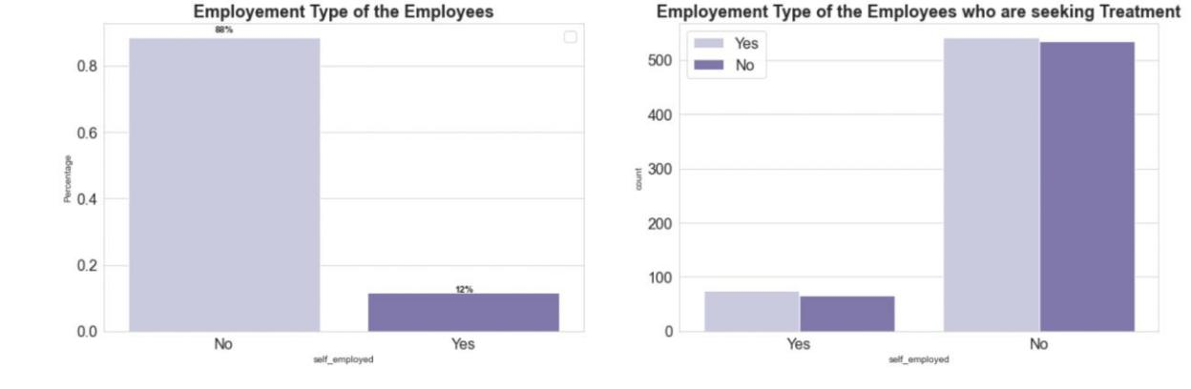
Most of the working-class employees responded to the survey when compared to the working class. But we can observe from the second graph that both classes have the same percentage of people who are seeking treatment.

Slide 12
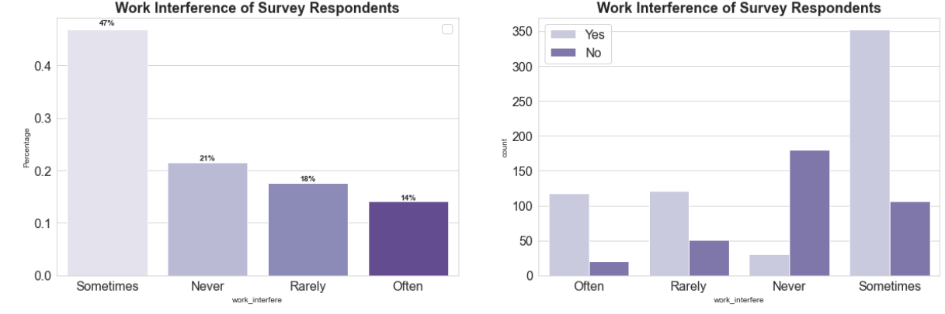
Around 70 percent of employees don't work remotely hence most of the mental health issues occur at the workplace. Number of employees seeking treatment in both the categories are more or equal.

Slide 13
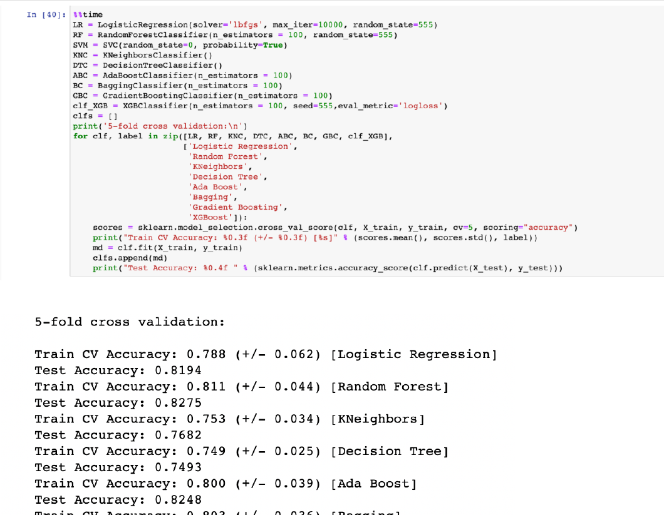
Creating and Evaluating the Models :

Slide 14
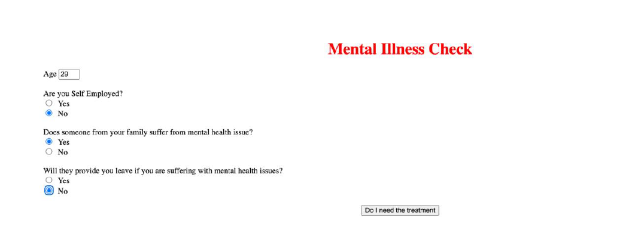
Hosting the web application
Here we used AWS for hosting the web Application into flask.
We used HTML to develop the user Interface for the Mental health check.

Slide 15
Results

Slide 17
Reference
https://www.researchgate.net/publication/268223440_Mental_health-related_stigma_in_health_care_and_mental_health-care
https://www.researchgate.net/publication/264502507_Employee_Health_in_the_M ental_Health_Workplace_Clinical_Administrative_and_Organizational_Perspectiv es
https://www.kaggle.com/code/aditimulye/mental-health-at-workplace

Slide 18



Thank you

